Slide 1
Providers and XML Processing without JAXB
Service-Oriented Software Engineering
Software Institute
Nanjing University
Bei Jia

Slide 2
Providers and XML Processing without JAXB
To deploy a Web service that enables you to work with XML messages directly, javax.xml.ws.Provider<T> interface, which defines a single method: T invoke(T request). Provider supports two usage modes:
  In Message mode, the SIB works directly with protocol-specific message structures. For example, when used with a SOAP protocol binding, the invoke method receives and returns SOAP messages
  In Payload mode, the SIB works with the payload of messages rather than the messages themselves. For example, when used with a SOAP protocol binding, the invoke method receives and returns the contents of the SOAP body rather than the entire SOAP message
JAX-WS specifies the classes that must be supported as type parameters for Provider<T>.
  It requires that all implementations support javax.xml.transform.Source in payload mode with all the predefined bindings (i.e., SOAP/HTTP, XML/HTTP)
  Likewise, JAX-WS implementations must also support Provider<SOAPMessage> in message mode in conjunction with the predefined SOAP bindings

Slide 3
Annotations in RequestOrderEndpoint.java
Identifies this Java class implements a Provider<T>
…
@WebServiceProvider(serviceName = "RequestOrderService",
portName="RequestOrderPort",
targetNamespace = "http://www.example.com/req",
wsdlLocation="WEB-INF/wsdl/RequestOrder.wsdl")
@ServiceMode(Service.Mode.PAYLOAD)
public class RequestOrderEndpoint implements Provider<Source> {
@Resource
WebServiceContext webServiceContext;
private static final String REQ_NS = "http://www.example.com/req";
private static final String OMS_NS = "http://www.example.com/oms";
public Source invoke(Source payload) {
…
Without a SEI or SIB, a WSDL is required
Information about the Web Service
Payload mode

Slide 4
XML Programming in invoke method RequestOrderEndpoint.java (1/3)
…
try {
DocumentBuilderFactory dbfac1 = DocumentBuilderFactory.newInstance();
DocumentBuilder docBuilder1 = dbfac1.newDocumentBuilder();
Document payloadDoc1 = docBuilder1.newDocument();
Transformer xformer1 = TransformerFactory.newInstance().newTransformer();
xformer1.transform(payload, new DOMResult(payloadDoc1));
payload = new DOMSource(payloadDoc1);
String errorMsg = validateAgainstWSDL(payload); //check the payload
if ( errorMsg != null ) {
SOAPFactory fac = SOAPFactory.newInstance();
SOAPFault sf = fac.createFault(
"SOAP payload is invalid with respect to WSDL.",
new QName("http://schemas.xmlsoap.org/soap/envelope/", "Client"));
Detail d = sf.addDetail();
SOAPElement de = d.addChildElement(new QName(
"http://www.example.com/faults", "inputMessageValidationFault"));
de.addAttribute(new QName("", "msg"), errorMsg.replaceAll("\"",""));
throw new SOAPFaultException(sf);
}…
Validation is your responsibility

Slide 5
XML Programming in invoke method RequestOrderEndpoint.java (2/3)
…
DocumentBuilderFactory dbfac = DocumentBuilderFactory.newInstance();
DocumentBuilder docBuilder = dbfac.newDocumentBuilder();
Document respDoc = docBuilder.newDocument();
Document payloadDoc = docBuilder.newDocument();
Transformer xformer = TransformerFactory.newInstance().newTransformer();
xformer.transform(payload, new DOMResult(payloadDoc));
Element responseElt =
respDoc.createElementNS(REQ_NS, "requestOrderResponse");
Element orderElt = respDoc.createElementNS(OMS_NS, "Order");
responseElt.appendChild(orderElt);
Element orderKeyElt = respDoc.createElementNS(OMS_NS, "OrderKey");
orderElt.appendChild(orderKeyElt);
// DOM build and translation
// generate a psuedo-unique 10 digit order ID
String orderId = Long.toString((new Date()).getTime());
orderId = orderId.substring(orderId.length()-10);
orderKeyElt.appendChild(respDoc.createTextNode(orderId));
Element orderHeaderElt = respDoc.createElementNS(OMS_NS, "OrderHeader");
orderElt.appendChild(orderHeaderElt);
…

Slide 6
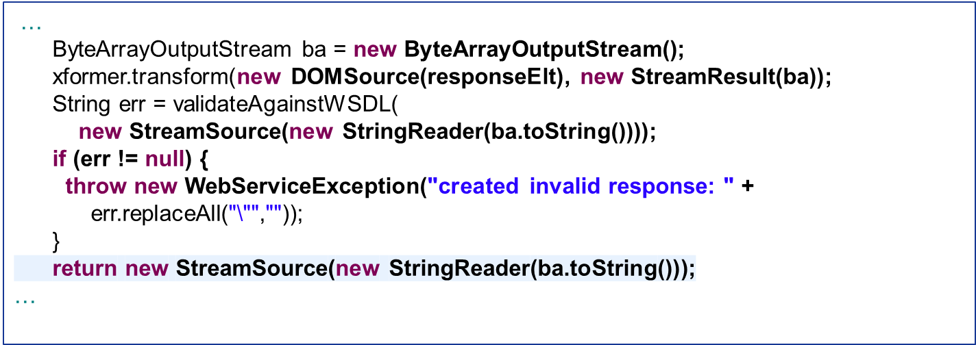
XML Programming in invoke method RequestOrderEndpoint.java (3/3)

Slide 7
Deploying Web Services Using Castor RequestOrderEndpoint.java (1/2)
…
if ( webServiceContext == null ) {
throw new RuntimeException("WebServiceContext not injected.");
}
MessageContext mc = webServiceContext.getMessageContext();
ServletContext sc =
(ServletContext) mc.get(MessageContext.SERVLET_CONTEXT);
if ( sc == null ) {
throw new RuntimeException("ServletContext is null.");
}
InputStream castorMappingFile =
sc.getResourceAsStream("/WEB-INF/castor/mapping.xml");
if ( castorMappingFile == null ) {
throw new IOException("Castor mapping file not found.");
}
Mapping castorMapping = new Mapping();
castorMapping.loadMapping(new InputSource(castorMappingFile));
Unmarshaller u = new Unmarshaller(castorMapping);
DocumentBuilderFactory dbf = DocumentBuilderFactory.newInstance();
DocumentBuilder db = dbf.newDocumentBuilder();
Document payloadDOM = db.newDocument();
Transformer xf = TransformerFactory.newInstance().newTransformer();
…

Slide 8
Deploying Web Services Using Castor RequestOrderEndpoint.java (2/2)
…
xf.transform(payload, new DOMResult(payloadDOM));
MyRequestOrder reqOrder = (MyRequestOrder) u.unmarshal(payloadDOM);
MyRequestOrderResponse response;
try {
response = reqOrder.processOrder();
} catch (PaymentException pe) {
SOAPFactory fac = SOAPFactory.newInstance();
SOAPFault sf = fac.createFault(pe.getMessage(),
new QName("http://schemas.xmlsoap.org/soap/envelope/", "Client"));
throw new SOAPFaultException(sf);
}
ByteArrayOutputStream ba = new ByteArrayOutputStream();
Marshaller m = new Marshaller(new OutputStreamWriter(ba));
m.setMapping(castorMapping);
m.marshal(response);
return new StreamSource(new StringReader(ba.toString()));
…

